Slide 1
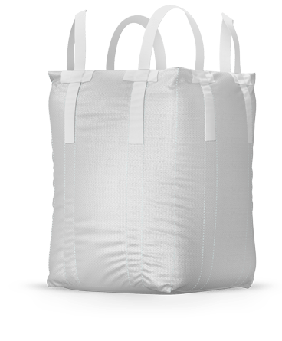
ESSENTIAL MIX OF ORGANIC MINREALS, VITAMINS AND AMINIO ACIDS WITH THE POWER OF
OPTIMATE HOOF RESCUE HELPS WITH
Myco-toxin binding for animal health and balancing rumen PH. Acidosis can contribute to laminitis.
Reduced foot health problems and strengthen building blocks of hoof walls.
Stimulates keratin production, the main structural element in hair and hooves.
WHY USE HOOF RESCUE?
Optimate Hoof Rescue includes a rumen protected Methionine making this more readily available for absorption through the gastrointestinal tract.
Optimate Hoof Rescue includes Biotin, Biotin is B-group vitamin and plays a key role in synthesis of glucose, protein and fat. Biotin is necessary for synthesis of keratin, a hard structural protein in horns and hoofs.
HEALTH AND SAFETY
Material safety data sheets are available on request.
DIRECTIONS FOR USE
Feed Optimate Hoof Rescue via mixer wagon, trough feeder or mixed on feed pads.
Suitable with maize and grass silage dairy meal, dairy blends.
Feed 60-120 grams per cow, per day.
Feed 20-40 grams per goat/sheep, per day.
Suitable to be fed to lactating dairy animals.
INGREDIENTS
Optimate™ ACVM Registration Number A011800.
Cows (Elemental): Maintenance 60g and Stress Period 120g dose:
60g contains: 10mg Biotin - 53g Optimate - 1500mg Zinc - 2g Rumen Protected Methionine
120g contains: 20mg Biotin - 106g Optimate - 3000mg Zinc - 4g Rumen Protected Methionine
Goat / Sheep (Elemental): Maintenance 20g and Stress Period 40g dose:
20g contains: 3mg Biotin - 17g Optimate – 500mg Zinc - 660mg Rumen Protected Methionine
40g contains: 6mg Biotin - 34g Optimate - 1000mg Zinc - 1320mg Rumen Protected Methionine
For more information visit www.bpmnz.co.nz
Code | Pack size
AGRI-0147 | 1 Tonne

